Slide 1

Stock Price Change Analysis using Python and Power BI
Sofian Syed
9/17/2024

Slide 2
Objective
This project focuses on analyzing stock price fluctuations and identifying key trends using historical market data.
The analysis includes calculating daily price changes, moving averages (such as 30-day averages), and cumulative price changes over time.
We aim to visualize how stock prices evolve daily and monthly to provide insights into market performance and volatility.

Slide 3

Data Source
The dataset used in this project was sourced from Yahoo Finance, containing comprehensive historical stock data.
The key columns in the dataset include:
Date: The trading date.
Open Price: The initial price at the beginning of the trading day.
Close Price: The final price at the end of the trading day.
Adjusted Close Price: The closing price adjusted for corporate actions like dividends and stock splits.
Volume: The total number of shares traded on a particular day.
This data allows for in-depth analysis of daily and monthly price movements, as well as trend forecasting based on market activity.

Slide 4

Data Processing in Python
1. Data Cleaning:
Loaded the stock dataset, checking for missing or inconsistent values.
Reformatted the date column to ensure consistency across the dataset.
2. Feature Engineering:
Created new columns such as:
Daily Price Change %: Calculated the percentage change between the closing prices of consecutive days.
Moving Average (SMA & EMA): Generated 20-day Simple Moving Averages (SMA) and Exponential Moving Averages (EMA) for trend analysis.
Volatility: Calculated 20-day rolling volatility to assess the stock's risk profile.
3. Data Modeling:
Applied statistical models and built predictive analysis for stock trends using historical data.
4. Performance Metrics:
Evaluated the model’s performance using Mean Absolute Error (MAE) to understand prediction accuracy.
5. Data Export:
Cleaned and transformed data exported for further visualization in Power BI.

Slide 5
Data Processing in Python
1. Data Cleaning:
Loaded the stock dataset, checking for missing or inconsistent values.
Reformatted the date column to ensure consistency across the dataset.
2. Feature Engineering:
Created new columns such as:
Daily Price Change %: Calculated the percentage change between the closing prices of consecutive days.
Moving Average (SMA & EMA): Generated 20-day Simple Moving Averages (SMA) and Exponential Moving Averages (EMA) for trend analysis.
Volatility: Calculated 20-day rolling volatility to assess the stock's risk profile.
3. Data Modeling:
Applied statistical models and built predictive analysis for stock trends using historical data.
4. Performance Metrics:
Evaluated the model’s performance using Mean Absolute Error (MAE) to understand prediction accuracy.
5. Data Export:
Cleaned and transformed data exported for further visualization in Power BI.

Slide 6
Key Measures & Columns Added Using DAX
In Power BI, used DAX (Data Analysis Expressions) to add custom measures and calculated columns, allowing us to derive deeper insights from the stock data. Here's an overview of the key calculations:
Moving Average (30 Days):
Purpose: To smooth out short-term fluctuations and highlight long-term price trends by averaging the closing prices over the last 30 days.
Benefit: Helps in identifying stock trends and filtering out noise from daily price changes.
Cumulative Price Change %:
Purpose: To track how much the stock price has increased or decreased over time, accumulating daily percentage changes.
Benefit: Provides a clear view of the overall growth or decline of the stock over a given period.

Slide 7
3. Daily Price Change %:
Purpose: To measure the day-to-day change in stock price as a percentage.
Benefit: Useful for understanding the volatility and price movement of the stock on a daily basis.
4. Month (Date Column Extraction):
Purpose: To group the data into months, allowing for monthly trend analysis.
Benefit: Enables the visualization of stock performance over months, making it easier to spot long-term patterns.
5. Average Monthly Price Change %:
Purpose: To calculate the average stock price change per month, highlighting monthly performance trends.
Benefit: Provides a summarized view of how the stock performed month-to-month, helping identify seasonal or cyclical behaviors.

Slide 8
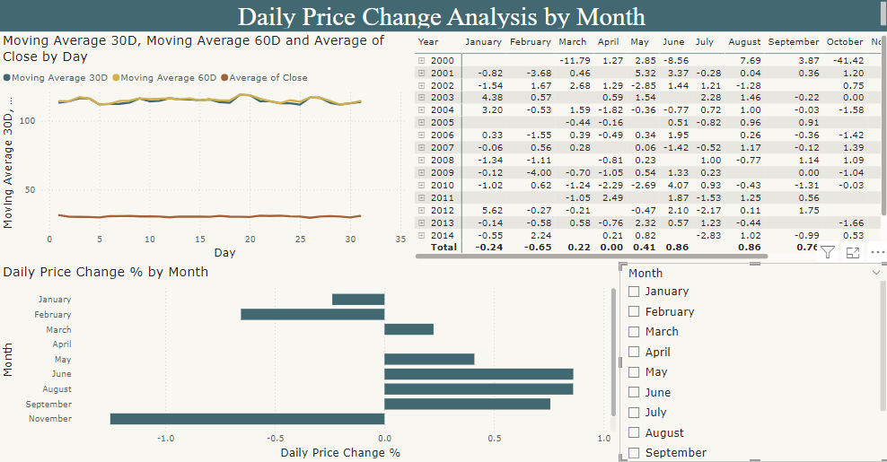

Slide 9
Explanation
The previous visualization slide provides an analysis of the Daily Price Change % across different months. A monthly filter is applied to allow users to focus on specific time periods and see how stock prices fluctuated daily within those months. Additionally, the moving averages (30-day and 60-day) are shown to give a clearer understanding of the overall price trend on specific days during the selected month. This helps in identifying short-term price movements and understanding how stock prices behave over different time frames.

Slide 10
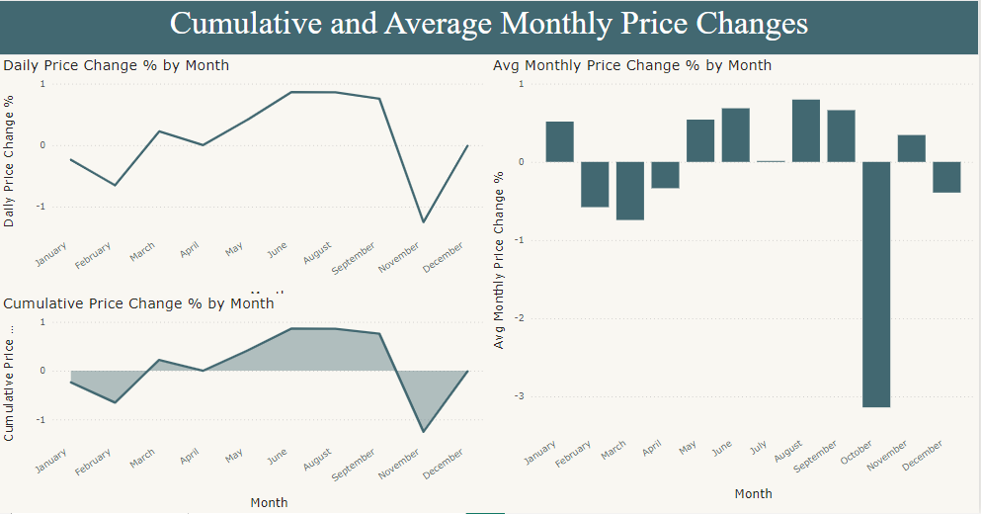

Slide 11
Explanation of slide-2
The 2nd slide visualizes the cumulative price change over time, illustrating the stock's overall performance from the start to the current period. The chart shows how the stock's value has increased or decreased by summing up daily percentage changes. This provides a clear understanding of the long-term trend, whether the stock has consistently grown, stagnated, or declined. The cumulative approach highlights the aggregated effect of daily fluctuations, offering a broader perspective on the stock's journey.

Slide 12

Conclusion
In this project, we utilized Python for data preprocessing and analysis, including cleaning the dataset, performing regression modeling, and calculating key financial metrics like moving averages. The results were then imported into Power BI, where we created interactive visualizations to explore daily price changes and cumulative trends over time. This approach allowed us to leverage Python’s analytical capabilities for accurate data processing while using Power BI's visual tools to present insights dynamically, aiding in a clearer understanding of stock performance and trends.

